Slide 1
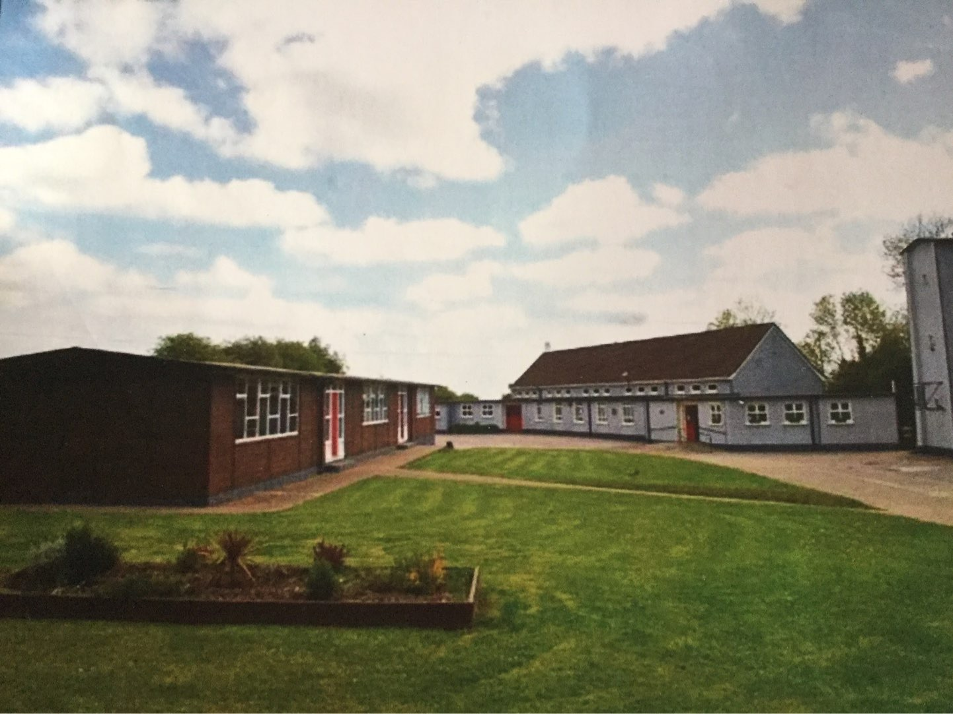
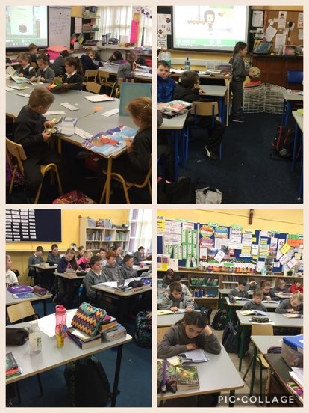
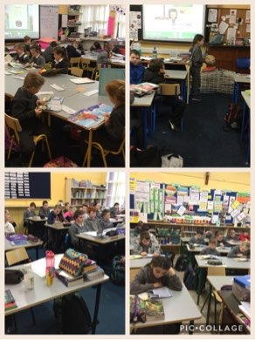
St. Molua’s National School New Infants Day 15/2/2019

Slide 2
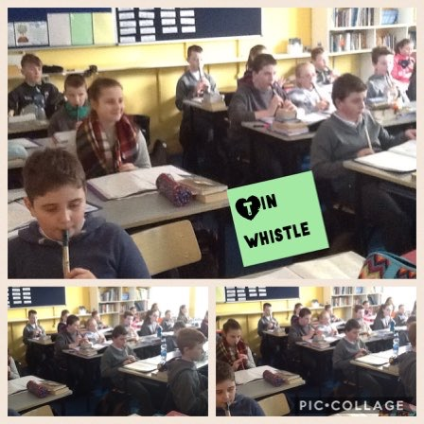
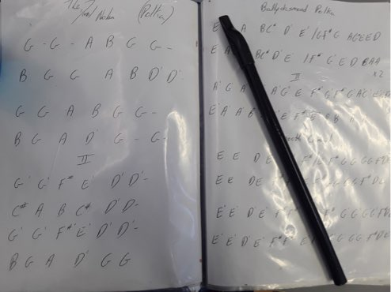
Students from juniors all the way up to the 6th class in Ardagh N.S have been learning the tin whistle with Norma Twomey. Recently we had a Christmas concert in the church. It was a huge success.We practised very hard in the lead up to the concert. We are continuing lessons every week with Norma. It is a great way for all of us to show off our talents.We really enjoy doing tin whistle lessons. We are hoping to have another concert next year.
Tin whistle

Slide 3
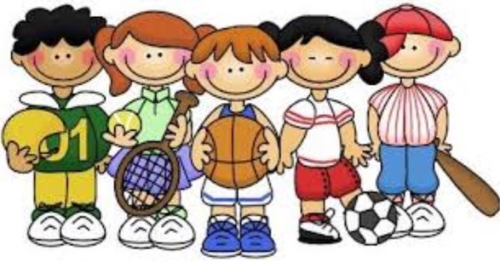
School playtime/P.E
Our school loves sport! Each morning we have a 10 minute break. And then later on we have a 30 minute lunch. In the summer we are lucky to have an excellent sports field behind our school that we are all allowed to use! Very soon we will have use of the brand new state-of-the-art astro turf pitch. At playtime we play soccer, catch, hopscotch and hide and seek and skipping. We recently had a full day skipping workshop which was excellent. We will be buying new ropes to promote this wonderful exercise. This year we will have a rugby, GAA and gymnastics coach.

Slide 4
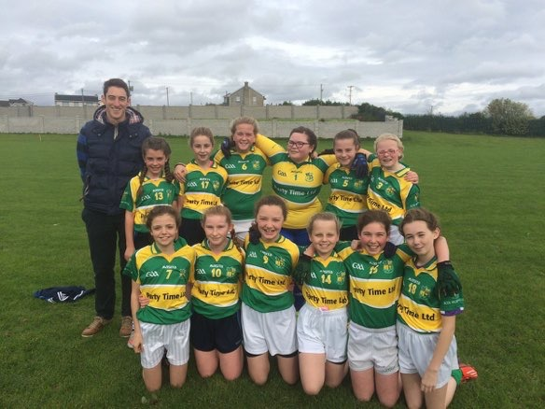
Sport & GAA
We have had lots of sport here at St Molua’s NS! We have played soccer, hurling, camogie, football and handball. We take part in both football and soccer tournaments every year. This year we had the priveledge of welcoming the Liam Mc Carthy Cup to the school along with TheLadies Footballers and the West County Cup. It was a privelidge to welcome back past pupil and star player with Limerick Ladies, Roisin Ambrose.
Success at St. Molua’s
5th and 6th class girl played the School's Football Final in Mick Neville Park in October, 2018. They did themselves and their school proud, having lost out to Adare on the day. Cliodhna Heffernan was also a successful member of the West Primary School’s Larkin Shield Football team. They beat the city in the final with Cliodhna playing at half back. Well done Cliodhna.

Slide 5
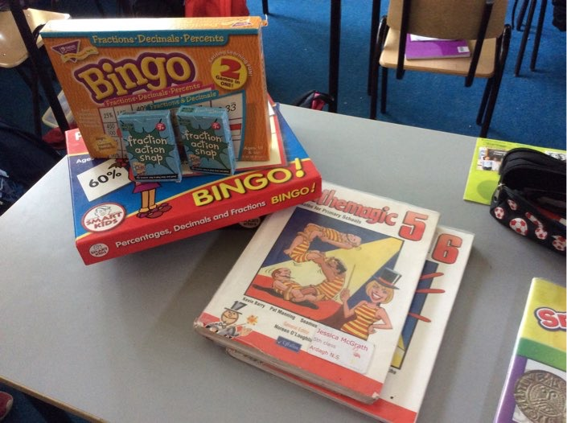
Whole School Evaluation
The school underwent a Whole School Evaluation by the Department of Education in April 2018. The report is published and available to be viewed online. The school got a great review overall with only a few minor recommendations. This is testament to the hard work of all the staff and the education of the child as a whole, with emphasis on the academic, social and emotional development of the child.

Slide 6
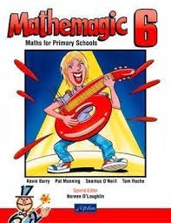
Maths in St. Molua’s NS
We love maths here in St.Molua’s NS. We use the interactive whiteboards and hands on materials to help us. We also use RUCSAC (Read, underline, chose, solve, answer and check) to help us with our problem solving. We have Maths Week every year where we have maths trails and fun problems.

Slide 7
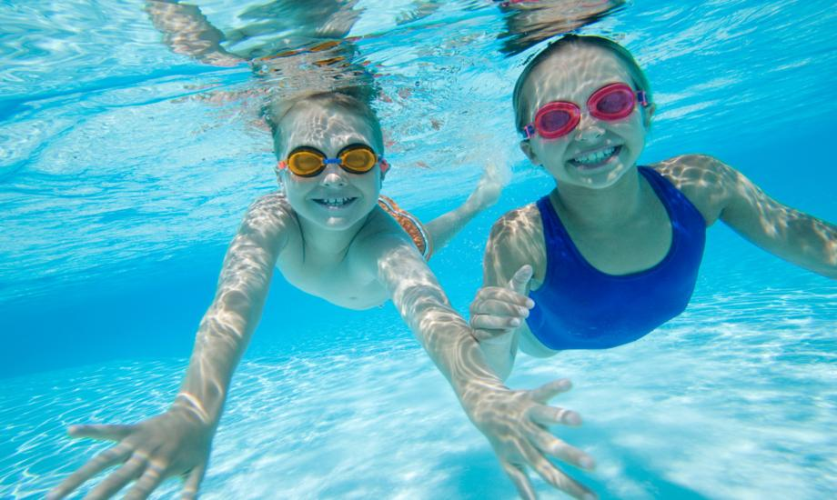
Swimming
We love swimming. Each class does swimming for six weeks every year. Our swimming starts at 1:15 and ends at 2:15. At the end of the six sessions every child is awarded a certificate.

Slide 8
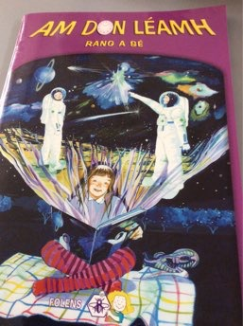
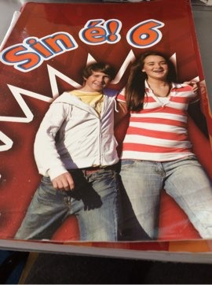
^{Is breá linn Gaeilge!}
Bíonn an spórt agus spraoi againn sa Ghaeilge!
Bíonn seans againn a bheith ag caint as Gaeilge gach lá.Léimid scéalta,canaimid amhráin agus imrímid cluichí teanga. Bíonn rang Gaeilge againn gach lá agus bainimid an taitneamh as!
Le Chéile
Is Féidir.

Slide 9
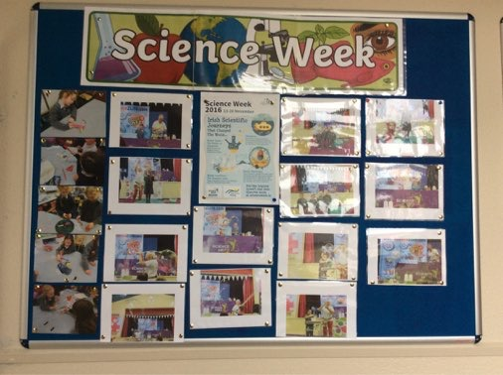
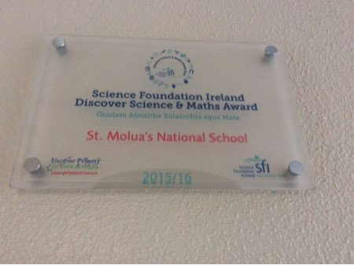
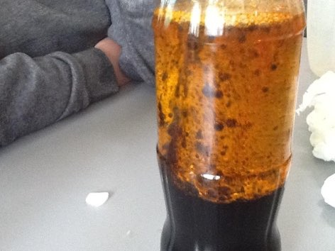
In 2018 our school won its third Discover Primary Science award. We did various experiments which were very interesting and we learned a lot. The school takes part in Science week every year. This year 1st to 4th attended St. Anne’s in Rathkeale for ‘Dr How’s Science Wows’ show. The theme was the water cycle and how it affects our daily lives. 5th and 6th class pupils went to U.L. to the Animal Magic Show. They also attended a show on the science of all things that spin, featuring bizarre bicycles, golf putters and yo-yo’s that always come back.
We love science and we are very interested in learning more.
Science

Slide 10
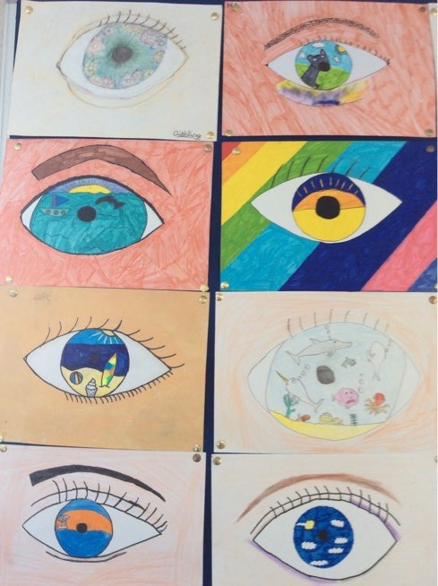
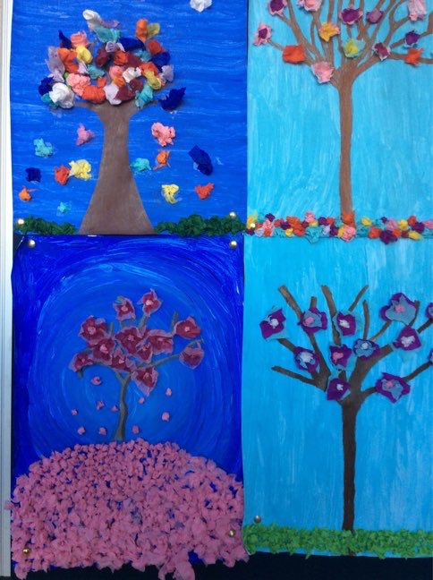
ART
Art is a very important subject in our school. We have done multiple types of art this year in school. We have created beautiful pieces of eye art and some art inspired by blossom trees..

Slide 11
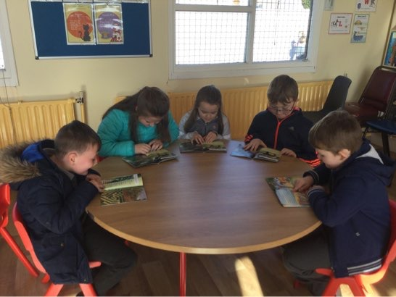
Literacy lift off
Literacy Lift Off is a six week intensive literacy intervention.
For one hour every day the children go to the
literacy room.They work in five small groups with a teacher to each group. There are over 1000 books in our literacy room.First and second class pupils have made a huge amount of progress so far this year with this programme.

Slide 12
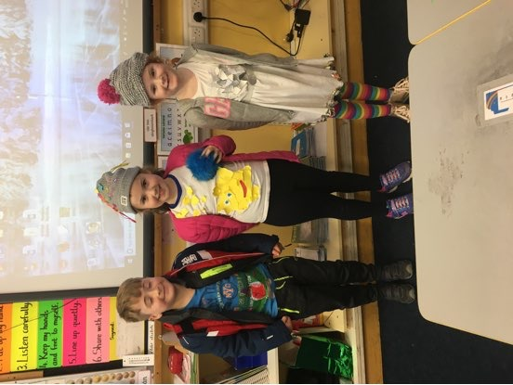
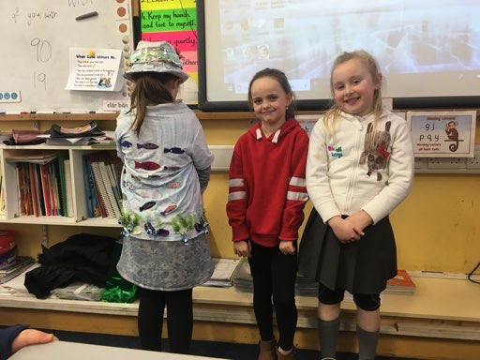
Green Flag
Thanks to Mr. Hayes and The Green School’s Team, our school has been assessed and recommended for our first Green Flag. This is a great achievement and we are looking forward to the flag raising ceremony in May. As a result of working towards the Green Flag, there is a much bigger awareness of reducing waste and recycling as much as possible. On assessment day, pupils were asked to wear either a jumper, hat or outfit made from recyclable materials. A huge effort was made by all pupils and some of the outfits on the day were fabulous.

Slide 13
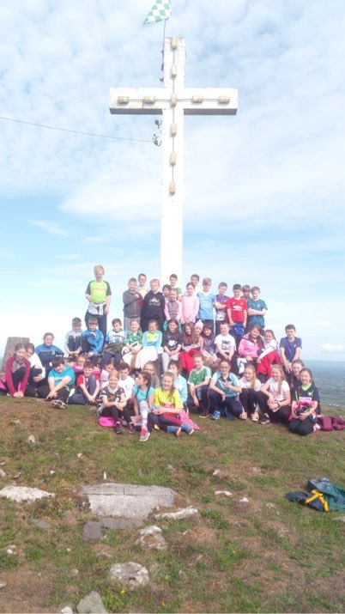
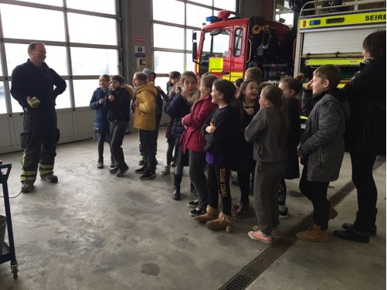
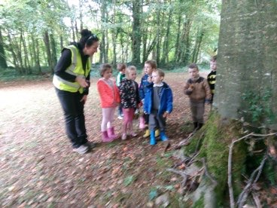
Every year we go to Curraghchase on National Tree Day, usually in October. We learn about the various types of trees growing there and are given a talk on the colony of bats that live in Curraghchase House. Last Autumn, 3rd to 6th took a trip to Knockfierna. We climbed the hill and learned about the history of the area from local historian, Pat Donoavan. 3rd and 4th class have also visited Newcastle West Fire Station and really enjoyed the experience.
Trips and Tours

Slide 14
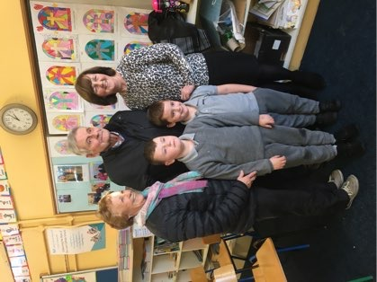
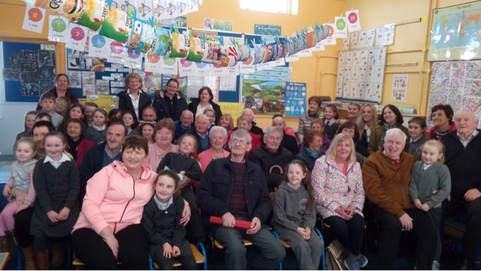
Grandparent’s Day
Every year we hold Grandparent’s Day. One class is chosen and the grandparents are invited in to hear the children sing, play the tin whistle, share their art work and so on. There is usually a guest grandparent who shares experiences with the children and a cup of tea afterwards. It is a lovely occasion and both children and grandparents usually look forward to it and enjoy it immensely.

Slide 15
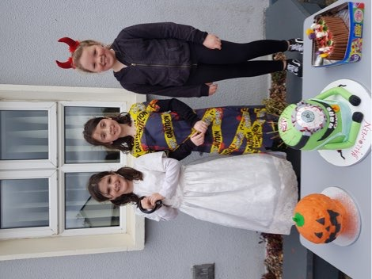
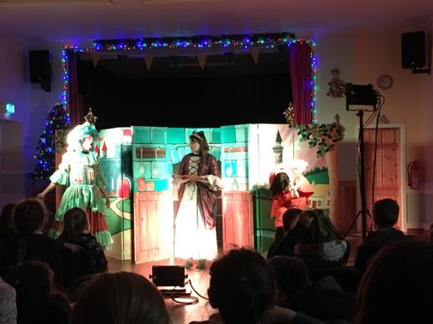
Special Events
To celebrate Halloween, we wear our costumes and hold a Bring and Buy Sale. This year the costumes were very imaginative. All the pupils and parents bake cakes and treats and it’s always a great success. Over the last two years, we have donated over € 1,000 of the funds raised towards the new Astro Turf Pitch.
We also hold a Christmas Recital in the church every year. This is a very special evening, where the children get the opportunity to sing seasonal favourites and play the tin whistle. This year, we also took part in a concert to celebrate the Ardagh Chalice 150 Anniversary celebrations.
Every year also, West Midlands Theatre Company performs a seasonal special for children from Juniors to Fourth class in the Community hall. This is a huge hit with the children.

Slide 16
Child Wellbeing
There is a big emphasis on pupil wellbeing in our school. To promote self esteem and a positive educational environment, teachers in our school have completed a number of programmes to help them. Junior and Senior Infants are being taught the Zippy’s Friends Programme. All classes will be taught Friends For Life and next year it is hoped to roll out the Incredible Years Programme starting with the junior classes.

Slide 17
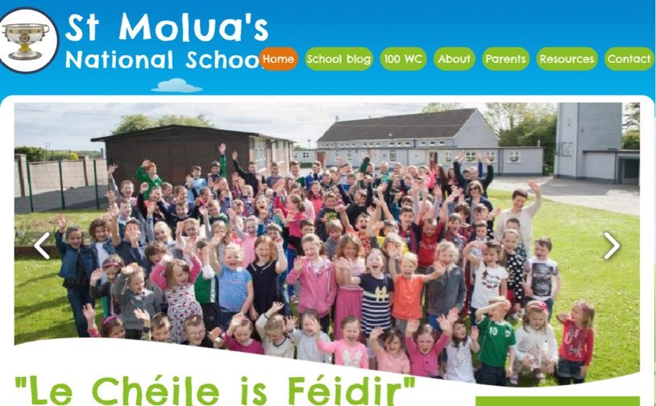
Keeping up with St. Molua’s N.S
Website: https://www.stmoluasns.ie/
Winner of Scoilnet’s Star Award – As published in
INTO’s monthly magazine in September 2018
Twitter: @st_ns
Email: office@stmoluasns.scoilnet.ie
Phone: 069-76353

Slide 18
Thank You
Thanks for coming to visit our school today.
We hope we have given you an overview of all the activities in our school.
We are very proud of our school and hope this came across in our presentation.
We hope your child will be happy here and enjoy all our school has to offer.

Slide 19
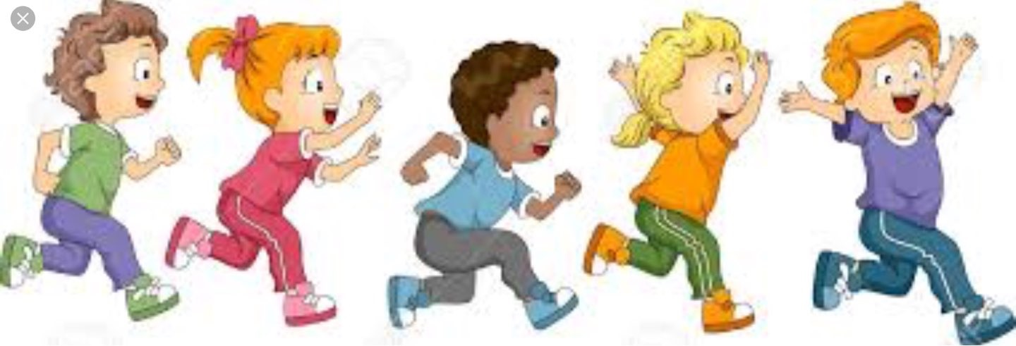
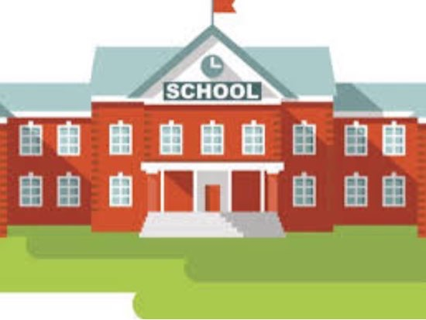
Did you enjoy our presentation?

